Slide 1

MINI PROJECT
DISASTER RESPONSE & MONITORING ROVER
Amal S Kannan
TEAM A7
Abhitha Francis - KTE23EC009
Aiswarya N L - KTE23EC016
Arjun N K - KTE23EC026
Shilpa Ann Varghese - KTE23EC059
RIT KOTTAYAM

Slide 2
Introduction
      This belongs to the domain of Intelligent Robotics and Embedded Systems.
      Used for Surveillance and disaster response applications
      Integration of sensors, camera, and wireless communication
      Real-time monitoring, alerting, and decision support.
      Human entry into disaster zones is dangerous.
      Reduces risk to rescue personnel.
      Enables early victim detection and hazard assessment.
      Relevant due to the increase in natural disasters and industrial accidents.
      Need for fast and safe surveillance systems
2

Slide 3
Project Overview
Motivation
      Addresses real-life problems in disaster and rescue operations
      Focus on human safety and risk reduction.
      To develop a low cost, intelligent, and scalable disaster response solution
Problem
Limitation
      Rescue teams lack real-time information in hazardous zones.
      Human presence detection is difficult in collapsed or unsafe areas.
      Manual surveillance is slow and risky.
      Delay in identifying victims and hazardous conditions.
      High risk to human rescuers.
      Limited visibility in disaster environments.
      Difficulty in identifying trapped or unconscious victims.
      Lack of low-cost intelligent rescue robots.
3

Slide 4
Background Research
Existing system analysis
Conventional Rescue Approaches
Drawbacks
      Manual search and rescue by trained personnel.
      Sniffer dogs for victim detection.
      CCTV and fixed surveillance cameras.
      Drones for aerial monitoring.
      Basic remote-controlled robots.
      Thermal cameras for heat detection.
      High risk to human rescuers.
      Limited access to confined or collapsed areas.
      No continuous ground-level monitoring (drones limitation).
      High cost and complex operation.
4

Slide 5
LITERATURE REVIEW
IoT integrated smart rover system for disaster relief management
  IoT-based rover for disaster relief using ESP32 + Blynk
  Sensors: Temperature, Humidity, Gas, Flame, Vibration
  Real-time data acquisition & alerts
  Pros: Good environmental monitoring & remote operation
  Cons: No advanced human detection; mainly sensor-based
Design and implementation of an IoT-enabled rover with ESP32-CAM for object detection, environmen tal monitoring, and web-based control
  ESP32 + ESP32-CAM for IoT-enabled rover
  Real-time object detection (YOLO) & environmental monitoring
  Sensors: Ultrasonic, DHT11, MQ-2
  Web-based control via HTTP & live video streaming
  Pros: Low-cost, low-power, real-time detection
  Cons: Limited computation → may affect detection accuracy; HTTP latency in dynamic environments
5

Slide 6

PROPOSED SYSTEM
SOLUTION
      Human classification : human in motion or not in motion
      Low-cost and scalable design compared to advanced rescue robots.
      Live video streaming.
      Design an intelligent ground rover for surveillance and rescue.
      Use multiple sensors for human detection and hazard monitoring.
      Reduce risk to human rescuers by remote operation.
6

Slide 7
Project Objective
Main Goal
Expected outcomes
      Design an intelligent surveillance and rescue rover.
      Enable safe operation in hazardous environments.
      Detect and classify humans using sensors and camera.
      Identify environmental hazards like gas and abnormal temperature.
      Provide real-time monitoring and alerting.
      Reduce risk to rescue and security personnel.
      A fully functional rover with manual operation.
      Reliable human detection with image confirmation.
      Automatic alert system.
      Live video streaming.
      Demonstration of a low-cost, practical rescue solution.
7

Slide 8
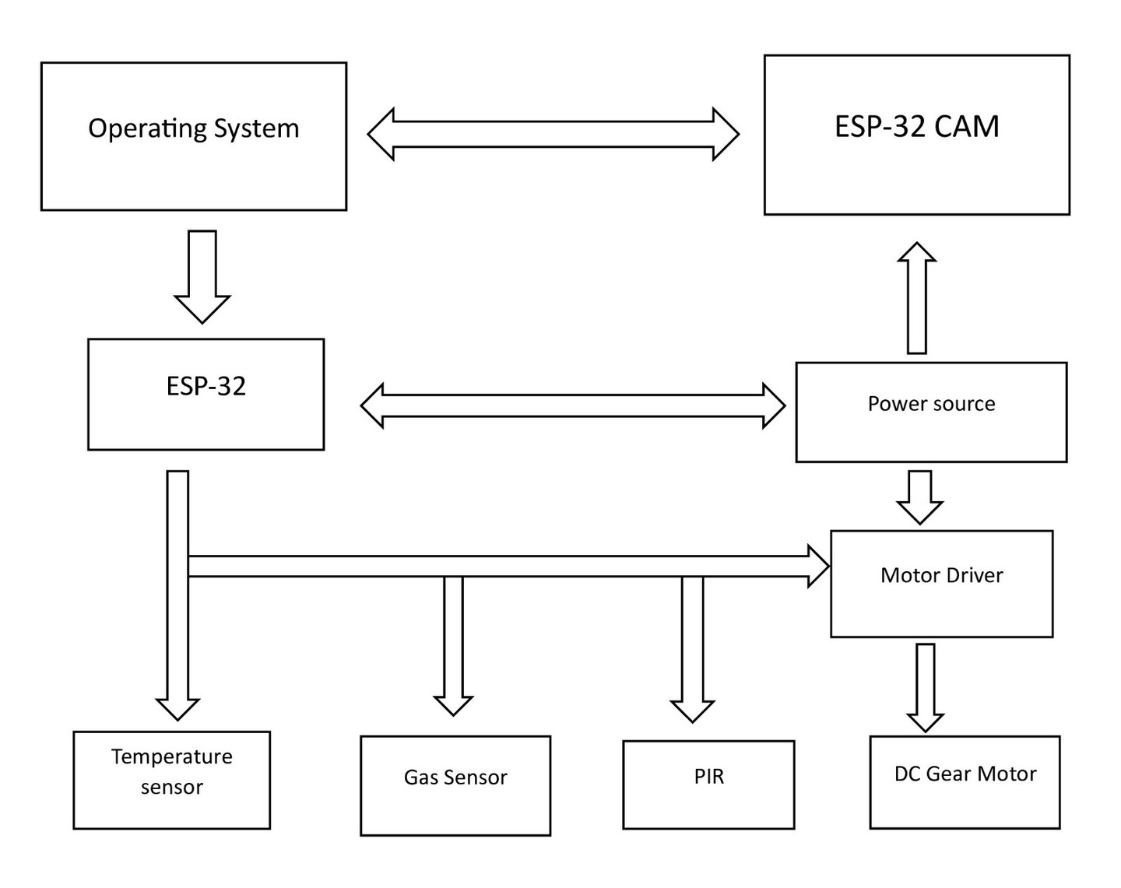
BLOCK DIAGRAM
8

Slide 9
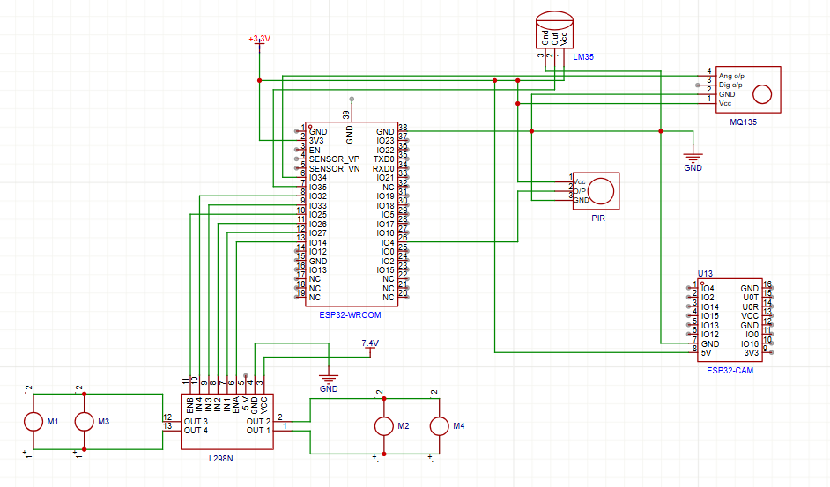
CIRCUIT DIAGRAM
9

Slide 10
Methodology
Keyboard-Based Rover Control via Web Interface:
Website is used to start the system and capture keyboard inputs, which are sent over WiFi to the ESP32 for controlling rover movement.
System Initialization
ESP32 and ESP32-CAM are powered ON, WiFi is established, and all sensors (PIR, LM35, MQ135) are initialized
Sensor Data Acquisition:
ESP32 continuously reads motion (PIR), temperature (LM35), and gas levels (MQ135)
Video Streaming & Processing:
ESP32-CAM streams live video to the laptop, where YOLOv8-pose is used for real-time human detection
Decision Making & Alerts:
Sensor data and YOLO results are combined to generate alerts (e.g., human detected, motion detected, hazard conditions) via Telegram.
10

Slide 11
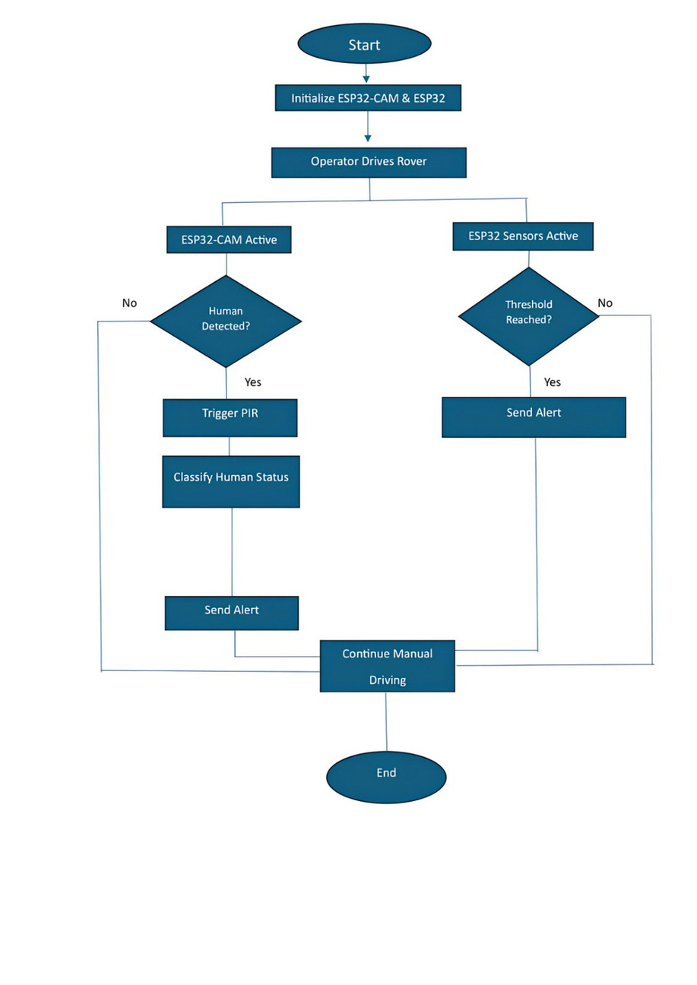
FLOW CHART
11
Notes:
1.7.2013
9
‹#›

Slide 12
REQUIREMENTS
Hardware
    Temperature Sensor – LM35
    LM35 range: −55 °C to 150 °C
    Used for fire or abnormal temperature detection
    Motor Driver Module – L298N
    Drives four DC motors
    Used to control speed and direction of motors
    DC Motors
    Geared motors for high torque
    Used for movement of the rover
    Battery & Power Supply
    Battery type: 3.7 V Li-ion
    Provides power to entire system
    ESP32-CAM
    Used to stream live video to operating device where yolo detection occur
    ESP32
    Reads sensors (PIR, gas, temperature)
    Controls motors via motor driver
    PIR Motion Sensor – HC-SR501
    Detects infrared radiation from human body
    Used for human presence detection
    Gas Sensor – MQ Series (MQ-135)
    Detects gases like LPG, methane, CO₂, smoke
    Used for toxic gas leakage detection
12

Slide 13
REQUIREMENTS
Software
Programming Languages
    C++ – For ESP32 programming & ESP32-CAM:
        Reading sensors (Gas, Temperature, PIR)
        Motor control (via motor driver)
        Reading sensor data
        Video streaming to operating device
    Python
    HTML & CSS
Frontend for web-based control interface
    Development platforms
      ESP32-CAM (Live video streaming)
      Arduino IDE
      ESP32 (Sensor & Motor Control)
Arduino IDE
      Website
VS Code
13

Slide 14
Cost Estimation
      ESP32 CAM-699
      ESP32 –- 399
      PIR Sensor – 65
      L298N – 119
      DC motor – 80*4
      Wheel-75*4
      MQ135 – 119
      Temperature Sensor – 125
      Li-ion Battery – 160
Total Estimated Cost = 2036
14

Slide 15
APPLICATIONS
      Real-World Applications Disaster search and rescue .
      Fire-affected and gas-leak environment monitoring.
      Surveillance in hazardous or restricted areas.
      Security monitoring in sensitive zones.
      Industry & Societal Usage Disaster management authorities – victim detection &
      hazard assessment.
      Industrial safety monitoring – gas leaks and fire detection.
      Police and security agencies – remote surveillance.
      Public safety environments – restricted area monitoring.
      Future Deployment Scope AI-based human detection and classification.
      Multi-rover deployment for large-area coverage.
      IoT-based centralized monitoring and alert system.
      Advanced autonomous navigation in complex terrains.
5
15

Slide 16
PROJECT PLAN
DATE | SCHEDULE OF ACTIVITY | STATUS
DEC 16TH -18TH | TOPIC FINALIZATION | COMPLETED
DEC 29TH | ABSTRACT SUBMISSION | COMPLETED
JAN 8TH | ZEROTH PRESENTATION | COMPLETED
JAN 12TH | CIRCUIT DESIGN | COMPLETED
JAN 16TH -20TH | PROCUREMENT OF COMPONENTS,BASIC COMPONENTS TESTING | COMPLETED
JAN 24TH -28TH | CAMERA,COMMUNICATION ,DETECTION SETUP | COMPLETED
JAN 29TH | SUBMISSION OF FIRST PHASE OF PROJECT | COMPLETED
FEB 1ST -7TH | SENSOR INTERFACING | COMPLETED
FEB 8TH -18TH | MOTOR DRIVER &ROVER MOVEMENT TESTING | COMPLETED
FEB 26TH –MAR 1ST | SYSTEM INTEGRATION & DEBUGGING | COMPLETED
MAR 10TH- MAR 15TH | PERFORMANCE TESTING | COMPLETED
MAR 15TH -26TH | DOCUMENTATION ,PPT PREPARATION &FINAL DEMO | COMPLETED
MAR 11TH -12TH | SUBMISSION OF PROJECT | COMPLETED
16

Slide 17
CONCLUSION
      Reliable and cost-effective disaster response solution.
      Operates in hazardous and inaccessible environments.
      Uses multi-sensor detection for accurate monitoring.
      Identifies humans in real-time.
      Generates instant alerts for rapid response.
      Enhances rescue efficiency while reducing risk to responders.
      Suitable for disaster management, industrial safety, and security.
      Future scope: AI-based intelligence and advanced autonomous navigation.
17

Slide 18

[1] E. Pragatheeswari, D. Dhanushree, V. Vishnu Priya, and G. Nisanth,,“IoT integrated smart rover system for disaster relief management,” in Proceedings of the 2nd International Conference on Sustainable Computing and Smart Systems (ICSCSS), 2024.
[2] A. R. Kalaiarasi, T. Deepa, D. Subbulekshmi, S. Angalaeswari, K. Thiagarajan, and K. S. Sundar,“Design and development of land rover for disaster management,” in Proceedings of Innovations in Power and Advanced Computing Technologies (i-PACT), 2023.
[3] M. Vimal, K. Sathyabama, and A. Abishek,“Design and implementation of an IoT-enabled rover with ESP32-CAM for object detection, environmental monitoring, and web-based control,” in Proceedings of the International Conference on Multi-Agent Systems for Collaborative Intelligence (ICMSCI), 2025.
[4] D. Roshan, D. Mahesh, N. V. S, and M. Catherine V. G, “Deep learning-based human detection rover for AI-powered search and rescue in dis aster zones,” in Proceedings of the 11th International Conference on Smart Computing and Communications (ICSCC), 2025.
[5] S. Dhanya, A. R. Ambili, S. Subhash, B. P. Sutheerth, R. Rohit, and S. Nandagopal,“Intelligent rescue rover for human detection using transfer learning and embedded systems,” in Proceedings of the Advanced Computing and Communication Technologies for High Performance Applications (ACC THPA), 2025.
References
18

Slide 19
The End
THANK YOU :)

